Slide 1
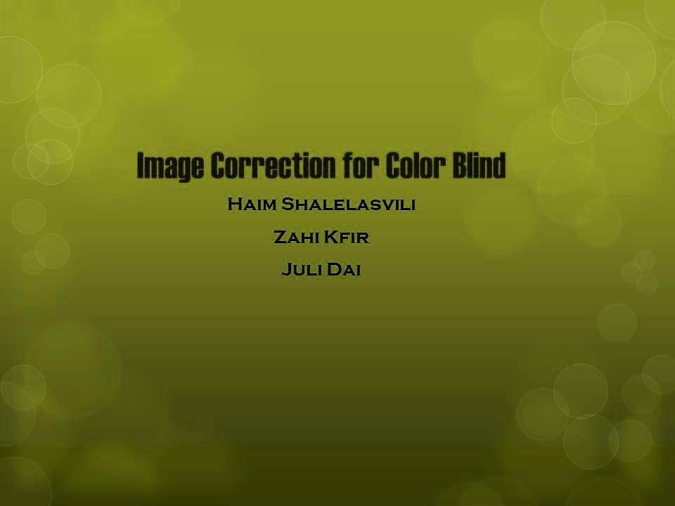
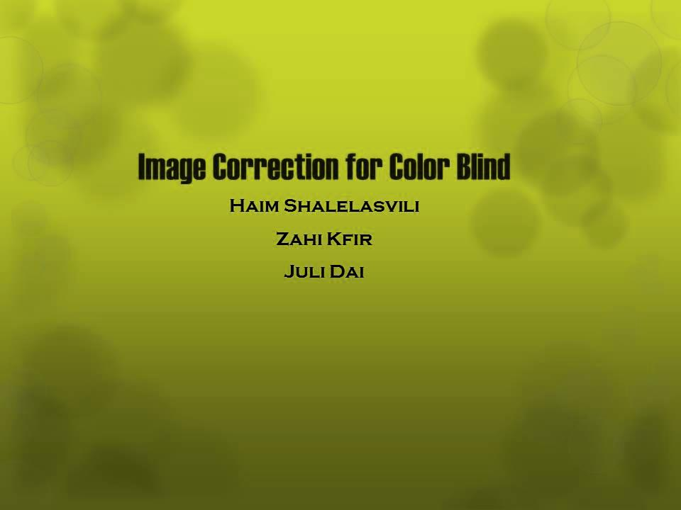

Slide 2
Image Correction for Color Blind
Haim Shalelasvili
Zahi Kfir
Juli Dai

Slide 3

From where to begin?
Analyze how color blind people perceive colors so we could determine what it is that we need to correct
Make a simulation so that people with normal vision can understand what color blind people see

Slide 4
Computerized simulation of color appearance for dichromats
Normal color vision is trichromatic
Reduced forms of color vision arise from the effective absence of one of the 3 retinal photopigments:
L type in protanopes
M type in deuteranopes
S type in tritanopes
For dichromatic observers any color stimulus initiates only two cone responses
All colors that they can discriminate are included in a two-dimensional color space

Slide 5
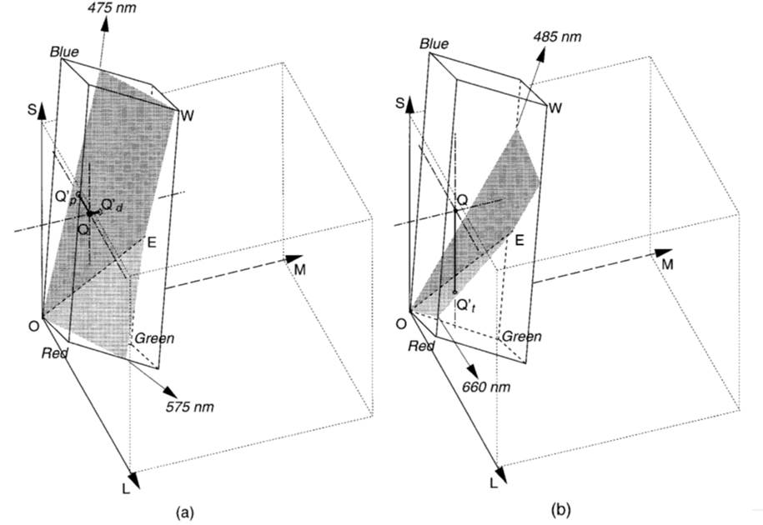
LMS based Simulation algorithm Implementation of the algorithm originally described in the paper: H. Brettel, F. Vi´enot, and J. D. Mollon. "Computerized simulation of color appearance for dichromats" J. Opt. Soc. Am., 14(10):2647–2655, 1997.
Represent color stimuli as vectors in a three dimensional LMS space
Simulation algorithm is expressed in terms of linear transformations in this space
The algorithm replaces each stimulus by its projection onto a reduced stimulus surface

Slide 6
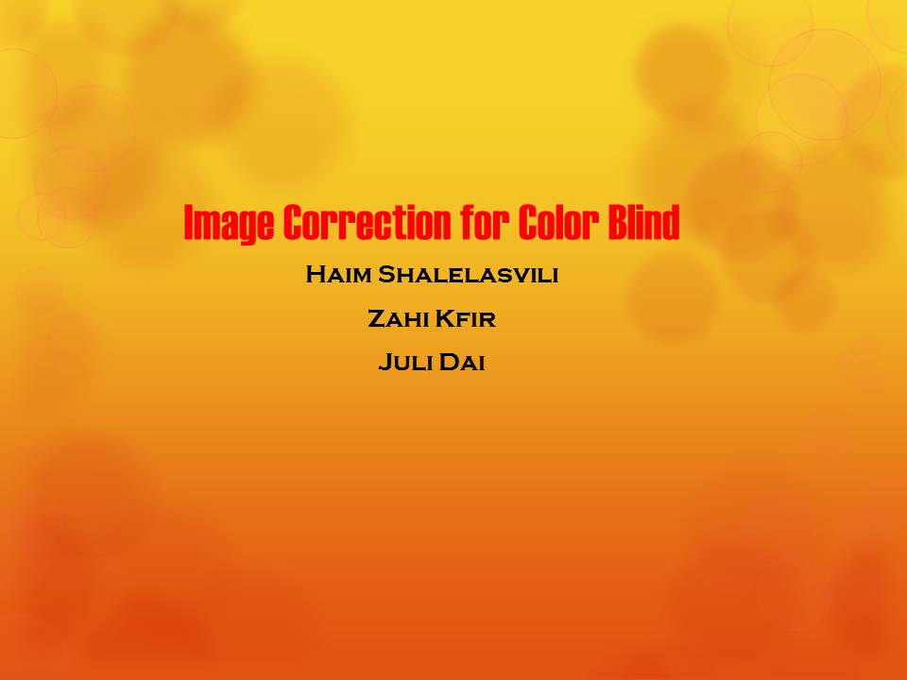
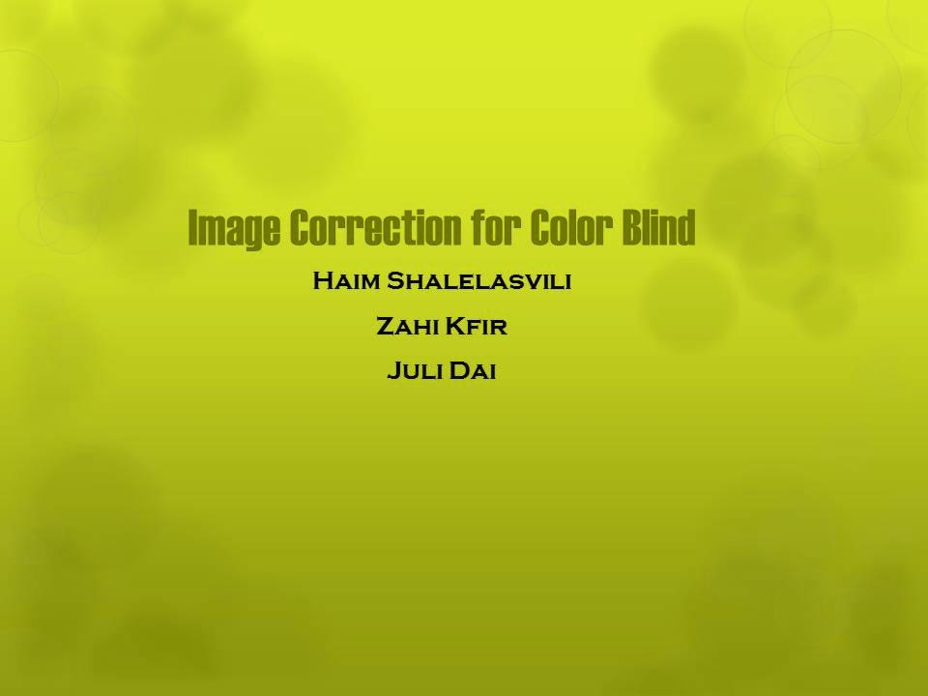
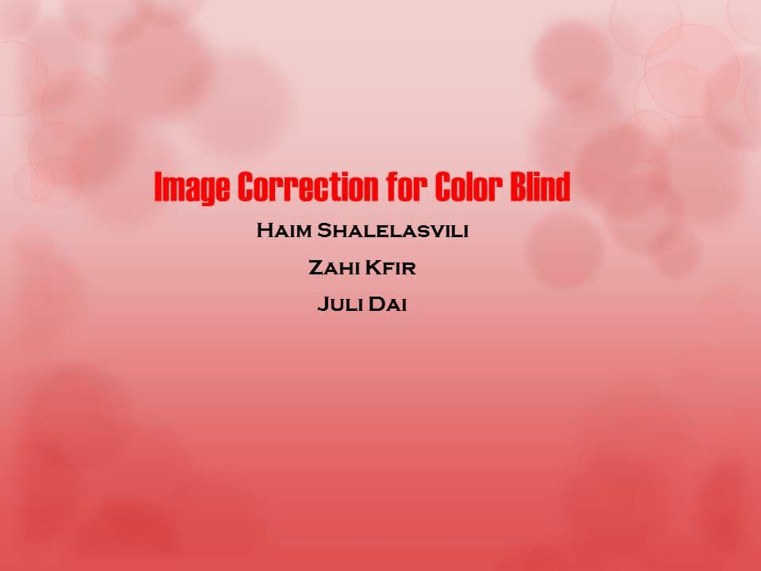
For Example

Slide 7
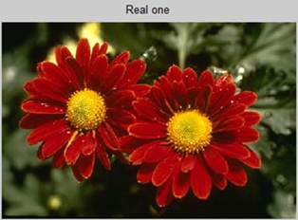
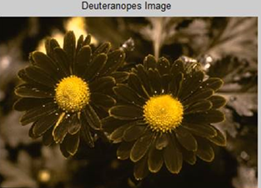
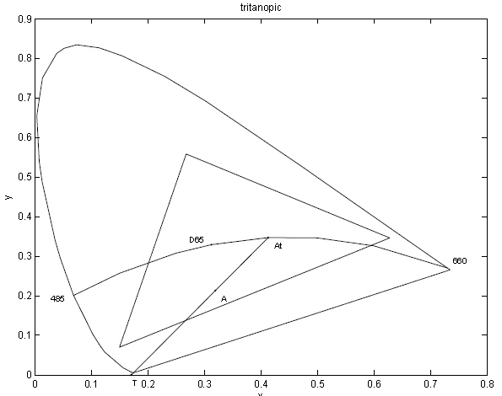
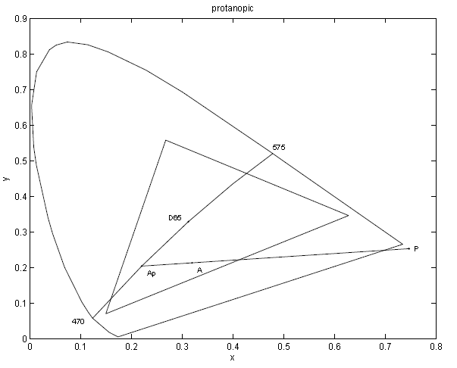
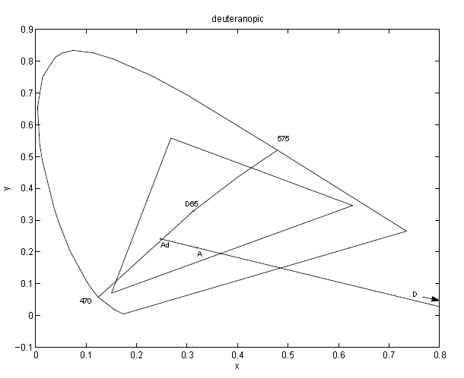
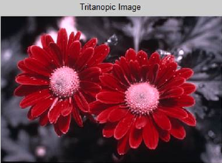
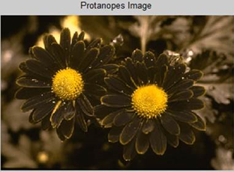
More Simulation Algorithms:
CIE xy based algorithm
Implementation of the algorithm originally described in the paper: Yinghua Hu: "VISUAL SIMULATING DICHROMATIC VISION IN CIE SPACE“

Slide 8

Next Step: Daltonize
Make certain modifications in digital pictures to make life easier for color blind people who use them
The basic idea:
calculate the error matrix:
|SimulatedImage – OriginalImage|
Make a linear transformation on this error matrix so that it can be conveyed, and add this on the original picture to find the daltonized image

Slide 9
Our Daltonize algorithm
Need to achieve 3 goals for two groups of pixels:
Ccorrect – colors that should not be changed
Cincorrect – color that must be daltonized
No color in Cincorrect should be daltonized to a color that the color blind people would perceive as similar to a color from Ccorrect
Based on 3 papers:
Analysis of Color Blindness
Intelligent modification for the daltonization process of digitized paintings
Intelligent Modification of Colors in Digitized Paintings for Enhancing the Visual Perception of Color-blind Viewers

Slide 10
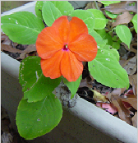
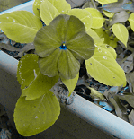
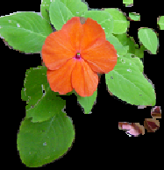
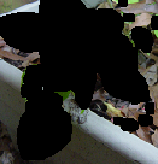
Daltonize algorithm Step By Step:
Initialize a transformation matrix M
Create quantized list of colors
Classify each color from list of colors, as belonging to Ccorrect or Cincorrect

Slide 11

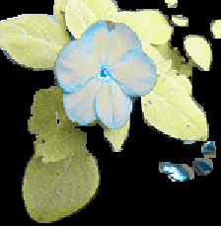
Daltonize algorithm Step By Step:
4. Apply color daltonization to every color in Cincorrect and name the resulting matrix Cdalton
5. Run protanope simulation on every color in Cdalton and name the resulting matrix Cprotanope
6. If there is no color conflict between Ccorrect and Cprotanope go to step 7. Otherwise go back to step 2, after modifying M
7. Produce the result image by replacing, in the original image, every color in Cincorrect with the corresponding color in Cdalton

Slide 12
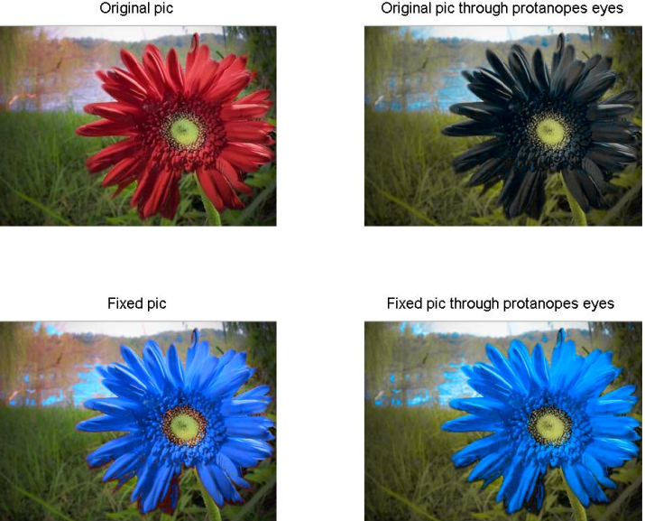
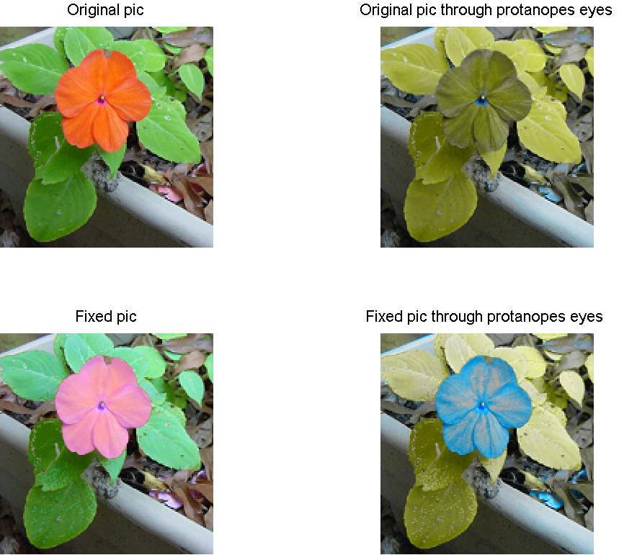
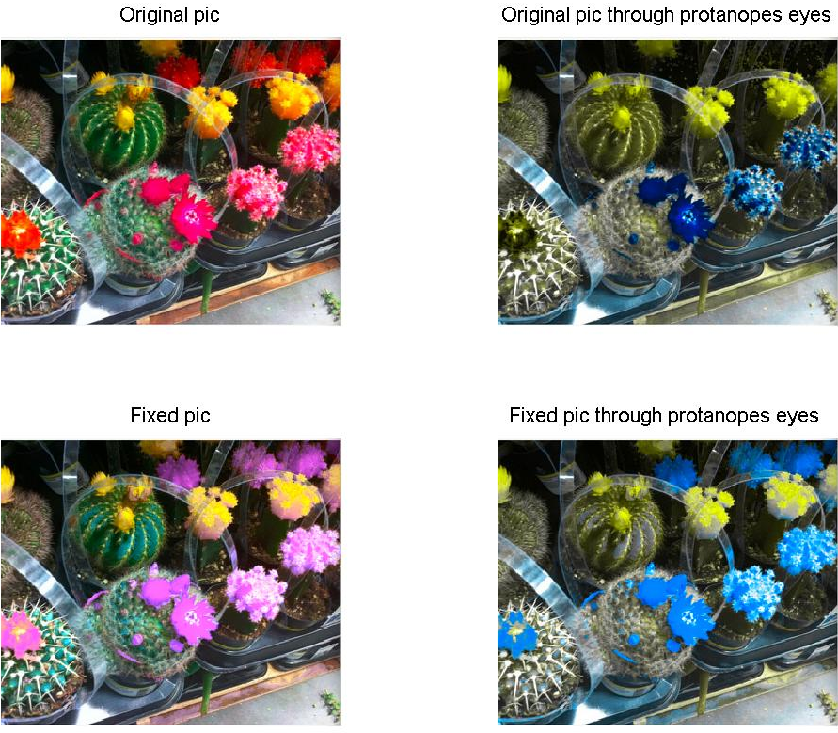
Results:

Slide 13
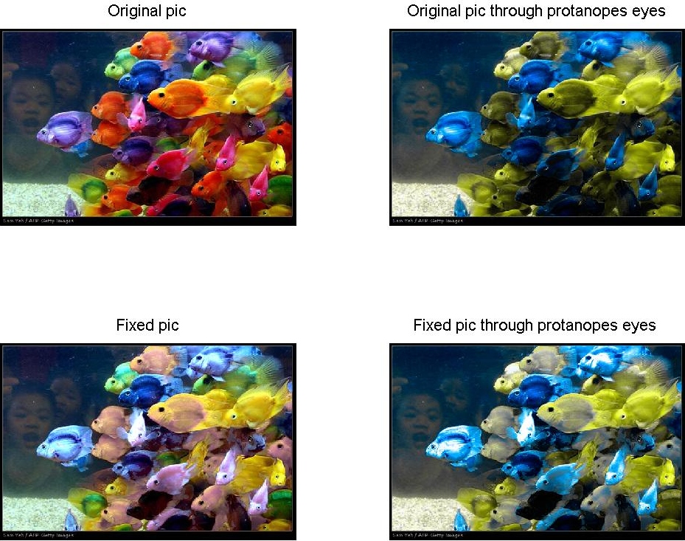
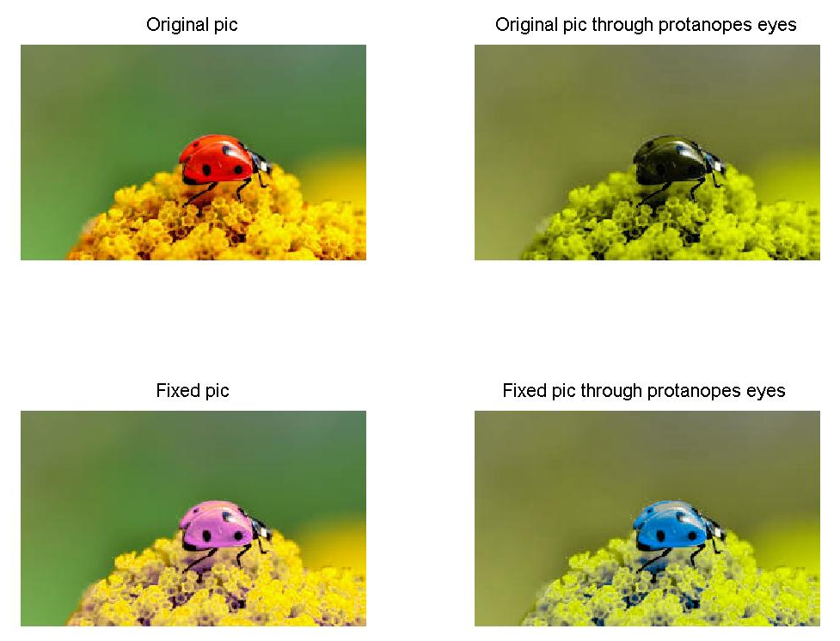

Slide 14
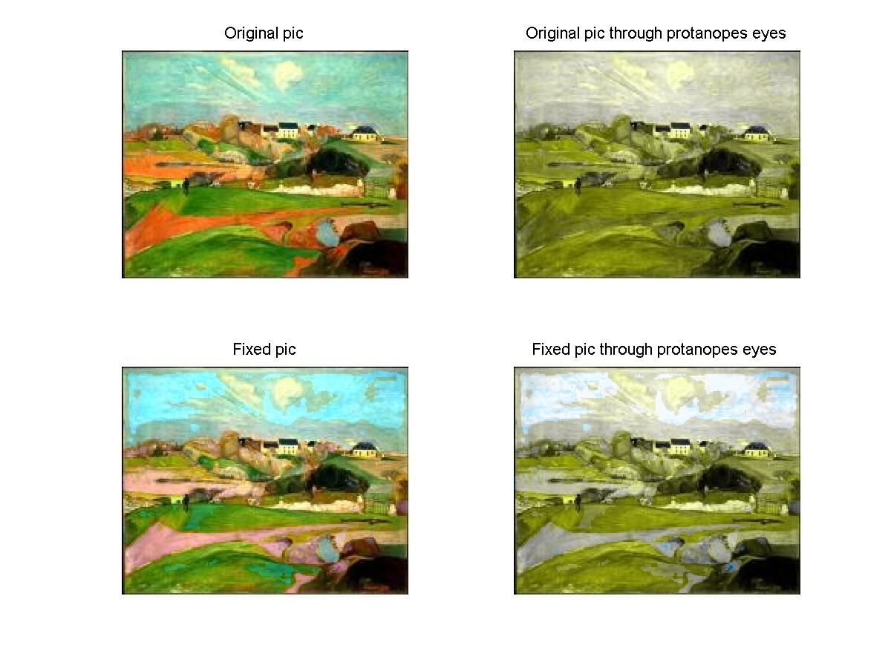

Slide 15
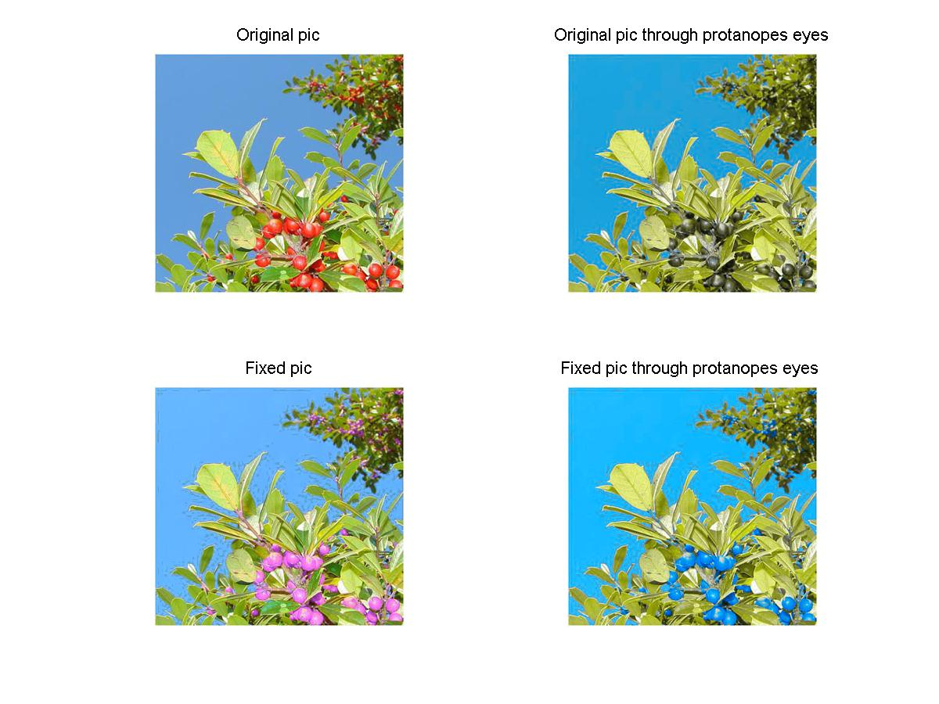

Slide 16
